Slide 1
Navigation Systems and Their Implementation
Michael Bekkala
Michael Blair
Michael Carpenter
Matthew Guibord
Abhinav Parvataneni
Dr. Shanker Balasubramaniam

Slide 2
Background
Accessibility
Popularity of GPS and INS
  Cell phones
    Apple iPhone, Blackberry, Android platform
  Nintendo Wii
    Wii Remote, MotionPlus

Slide 3
Background: GPS
First put into practical use in the 90’s. More commonly used in the 21st century
GPS is for navigation, syncing computer networks time, missile guidance
Some applications that make use of GPS are Garmin Car Navigation Systems, Google maps, mobile apps
GPS satellites are maintained by the Air force and can be used by anybody

Slide 4
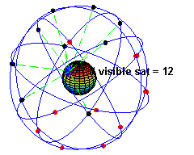
Global Positioning System (GPS): How it works
At least 24 operational GPS satellites in orbit
  12 hour orbit
  11,000 miles above earth
  Atomic clock
    Most accurate time and frequency standards known
  Synchronized, send signals at same time
http://en.wikipedia.org/wiki/Gps

Slide 5
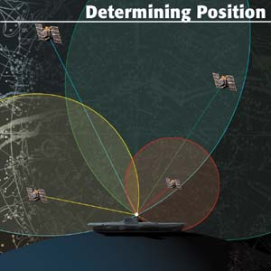
Global Positioning System (GPS): How it works cont’d.
Satellites send data to earth which are picked up by a receiver
Signals arrive at different times based on the distance from the satellite
  L1 (1575.42 MHz)
Receiver needs to determine distance to four satellites
  Determines 3-dimensional position
  Does not send out a signal
But how does the receiver determine its distance from each satellite?

Slide 6
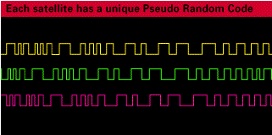
Global Positioning System (GPS): How it works cont’d.
To calculate distance:
  Distance = Speed • Time
Speed ≈ Speed of Light
How to determine time?
  Receiver’s clock becomes synchronized to Coordinated Universal Time (UTC) by tracking four or more satellites
  Each satellite transmits a unique “pseudo random” code at extremely precise time intervals
  Receiver knows each satellite’s pseudo random code and when they are sent
  Receiver determines the time delay it takes to match the expected satellite pseudo random code with the received pseudo random code
    Time Delay = Time!
Notes:
Explain what pseudo random code means – such complex code it appears random but really is not. Prevents crosstalk/interference, eliminates harmful effects of noise.
Remember clocks are synchronized! Use example of synched watches. Message sent at precisely noon. Friend received at exactly 12:05. assuming a straight line, and speed of light. Your friend is 90 billion meters away.

Slide 7
Global Positioning System (GPS): Sources of Error
Atmospheric Error
  Speed of light is only a constant in a vacuum
    Charged Particles in the Ionosphere
    Water Molecules in the Troposphere
Ephemeris Error
  Error that effects the satellite’s orbit (ephemeris)
  Caused by the gravitational pull of the sun, moon, and the pressure caused by solar radiation
  Error monitored by the Department of Defense (DoD) and broadcasted to the GPS satellites
Multipath Error
  Timing error from signals bouncing off of objects such as buildings or mountains
  Can be reduced by signal rejection techniques
How can we reduce errors caused by the atmosphere?

Slide 8
Global Positioning System (GPS): Error Correction: DGPS
DGPS = Differential GPS
Basic Idea:
  Use known locations as reference locations
    Exact Position is known, compare to the location determined by GPS
    Develop error correction data by using the difference of the exact location and the GPS determined location
  Broadcast error correction data to local GPS receivers (receivers within 200km of the reference station)
  Error correction can remove errors caused by the atmosphere—makes GPS data more accurate!

Slide 9
Global Positioning System (GPS):
Error Correction: WAAS
Wide Area Augmentation System (WAAS)
  WAAS is an example of DGPS
  Also referred to as a Satellite Based Augmentation System (SBAS)
  Developed by the Federal Aviation Administration (FAA)
  Uses a network of ground based stations in North America and Hawaii
  Measures variations in satellite signals
    Relays error to geostationary WAAS satellites
    Used to improve accuracy and integrity of data
  Independent systems being developed in Europe (Galileo), Asia, and India.

Slide 10
Global Positioning System (GPS):
Applications
Aerospace
Automotive
Military
Civilian
  Recreation
  Augmented Reality
The list goes on

Slide 11
Global Positioning System (GPS):
NMEA
National Marine Electronics Association 0183 (NMEA)
  A standard which defines communication between marine electronic devices
  Uses ASCII serial communication
    Can be read by the microcontroller over UART and parsed appropriately
  Defines message content
  http://www.gpsinformation.org/dale/nmea.htm

Slide 12
Global Positioning System (GPS):
NMEA Cont’d.
Requirements
  Contain complete position, velocity, and time (PVT) data
  Independent of other messages
  Begin with a ‘$’, end with a ‘\n’
  Content separated by commas
  No longer than 80 characters
  http://www.gpsinformation.org/dale/nmea.htm

Slide 13
Global Positioning System (GPS):
NMEA Cont’d.
$GPGGA,123519,4807.038,N,01131.000,E,1,08,0.9,545.4,M,46.9,M,,*47
GGA - essential fix data which provide 3D location and accuracy data
  GGA Global Positioning System Fix Data
  123519 Fix taken at 12:35:19 UTC
  4807.038,N Latitude 48 deg 07.038' N
  01131.000,E Longitude 11 deg 31.000' E
  1 Fix quality: GPS fix (SPS)
  08 Number of satellites being tracked
  0.9 Horizontal dilution of position
  545.4,M Altitude, Meters, above mean sea level
  46.9,M Height of geoid (mean sea level) above WGS84 ellipsoid
  (empty field) Time in seconds since last DGPS update
  (empty field) DGPS station ID number
  *47 Checksum data, always begins with *
  http://www.gpsinformation.org/dale/nmea.htm

Slide 14
Inertial Navigation System
The use of inertial measurements in navigation
Measurements come from inertial sensors such as:
  Accelerometers
  Gyroscopes
Very accurate over short term
Errors integrate with time

Slide 15
Physics of Accelerometers/Gyroscopes
Accelerometers
  Measure acceleration in x, y, z directions
  Types:
    Mechanical
    Micro Electromechanical (MEMS)
      Capacitive
      Piezoelectric

Slide 16
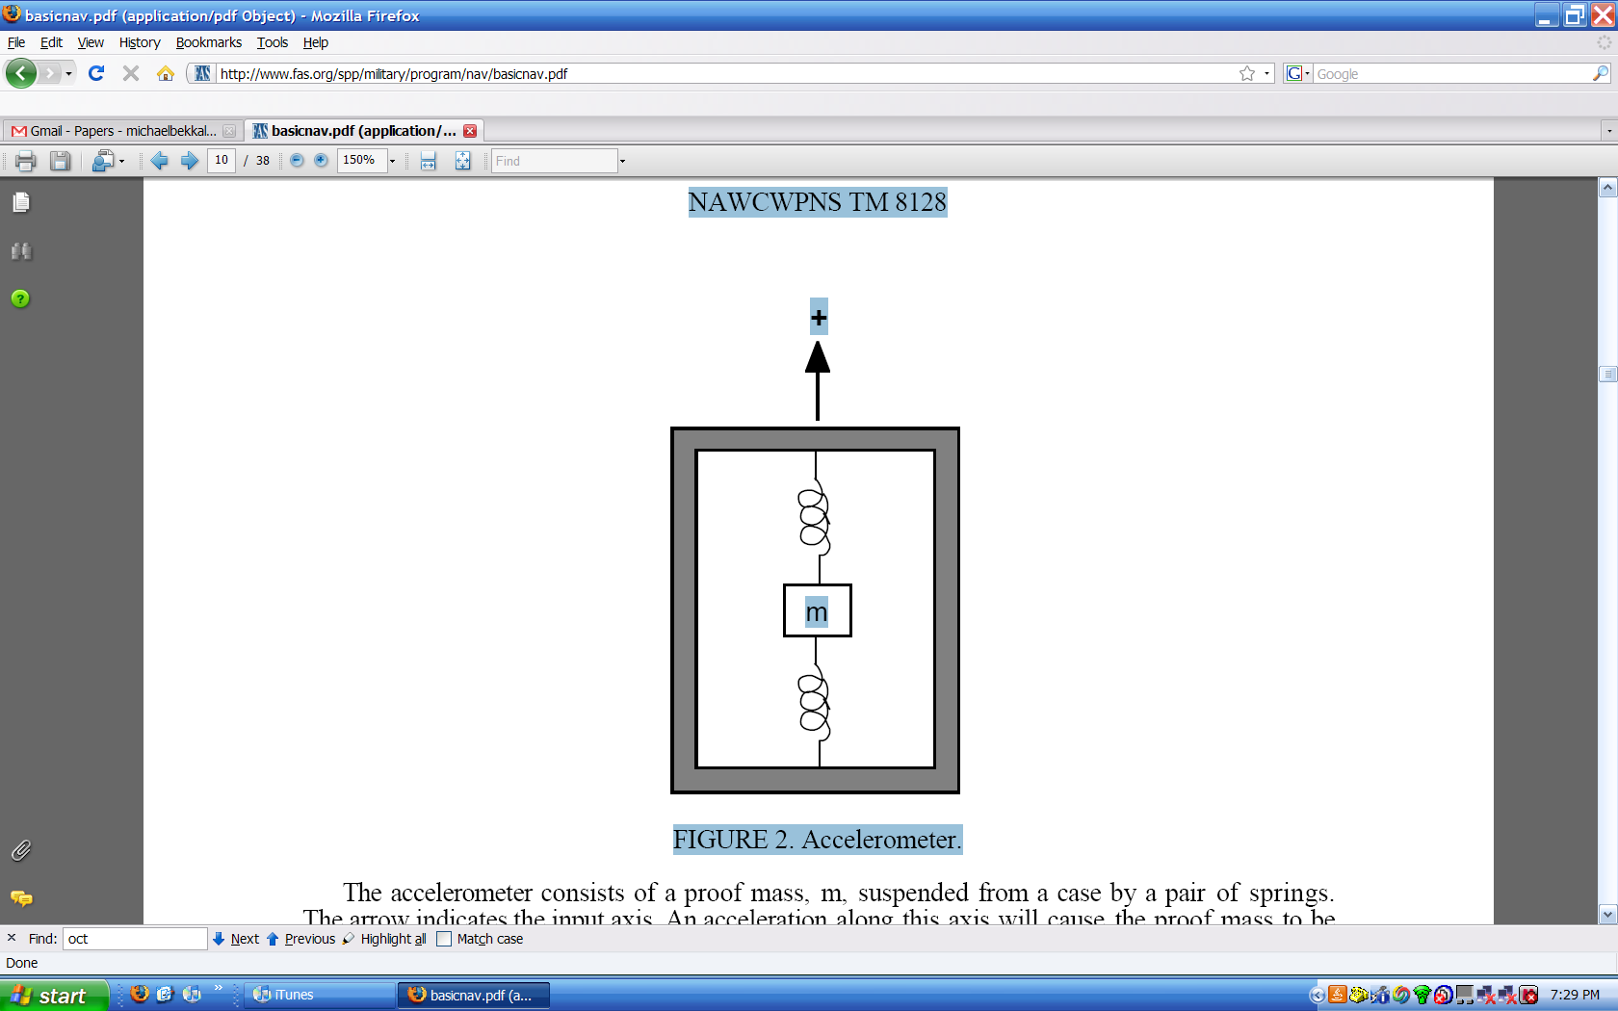
Mechanical Accelerometers
Mass suspended in a case by a pair of springs
Acceleration along the axis of the springs displaces the mass.
This displacement is proportional to the applied acceleration
Picture from “Basic Inertial Navigation” by Sherryl Stoval

Slide 17

Capacitive Accelerometers
Sense a change in capacitance with respect to acceleration
Diaphragm acts as a mass that undergoes flexure
Two fixed plates sandwich diaphragm, creating two capacitors
Change in capacitance
by altering distance between
two plates
Most common form
http://www.sensorland.com/HowPage011.html

Slide 18
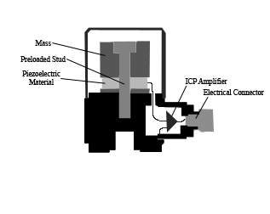
Piezoelectric Accelerometers
Force exerted by acceleration
changes voltage generated by material
Low output signal and high
output impedance requires
the use of amplifiers
Commonly uses 1 crystal
made of quartz
Picture from Wikipedia.org

Slide 19
Physics of Accelerometers/Gyroscopes
Gyroscopes
  Measure Angular velocity in yaw, pitch, and roll directions
    Mechanical
    Micro Electromechanical (MEMS)
    Optical
Notes:
19

Slide 20
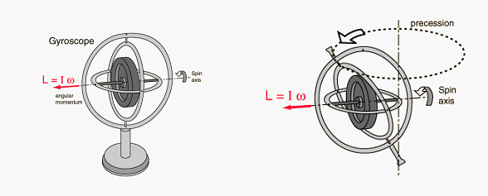
Mechanical Gyroscopes
Spinning wheel on 2 gimbals
When subject to rotation, wheel remains constant and angles adjacent to gimbals change.
Measures angular
position
Picture from http://www.howyourelectronicswork.com/2008/09/fiber-optic-gyroscopes.html

Slide 21
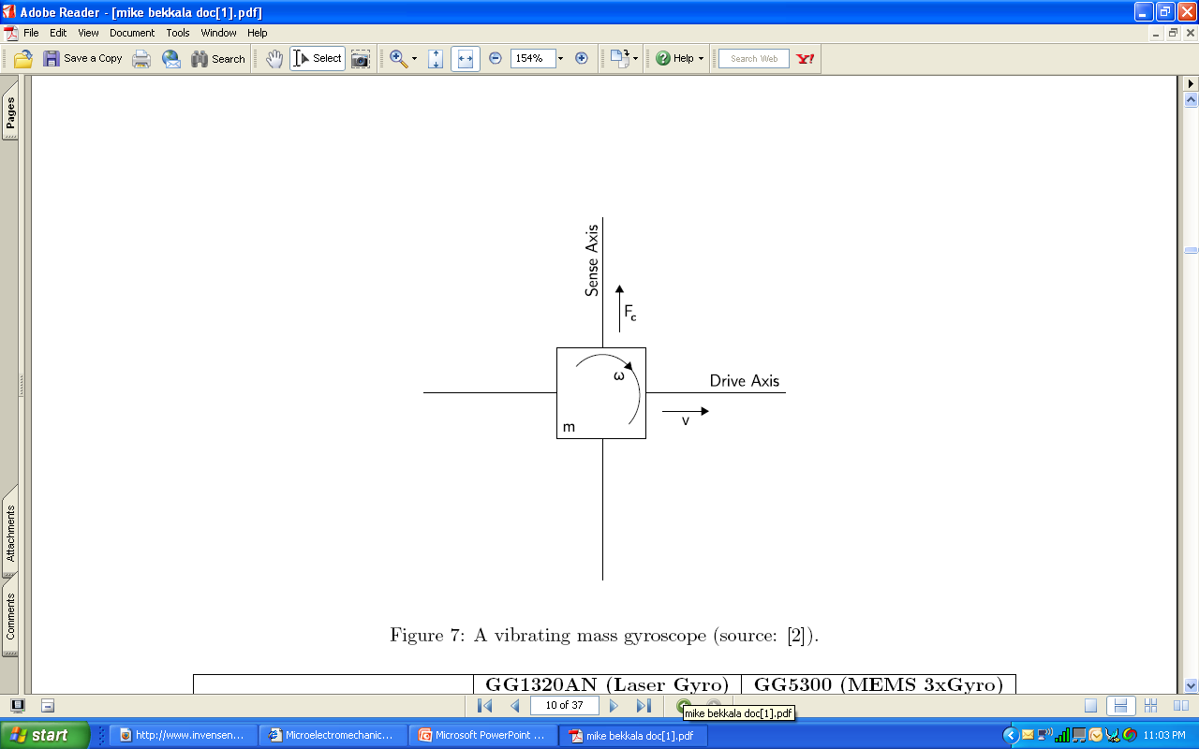
Micro Electromechanical Gyroscopes
Coriolis effect
Vibrating elements measure Coriolis effect (vibrations on sense axis)
Measures angular velocity
Low part count
Picture from “An introduction to inertial navigation” by Oliver Woodman

Slide 22
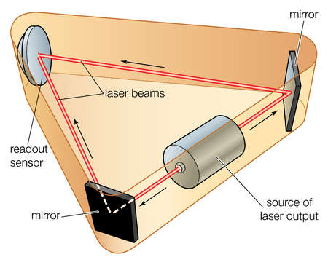
Optical Gyroscopes
Sends out two beams of light
Sensor can detect interference in the light beam
Very accurate
No inherent drift
Picture from http://www.howyourelectronicswork.com/2008/09/fiber-optic-gyroscopes.html
Notes:
22

Slide 23
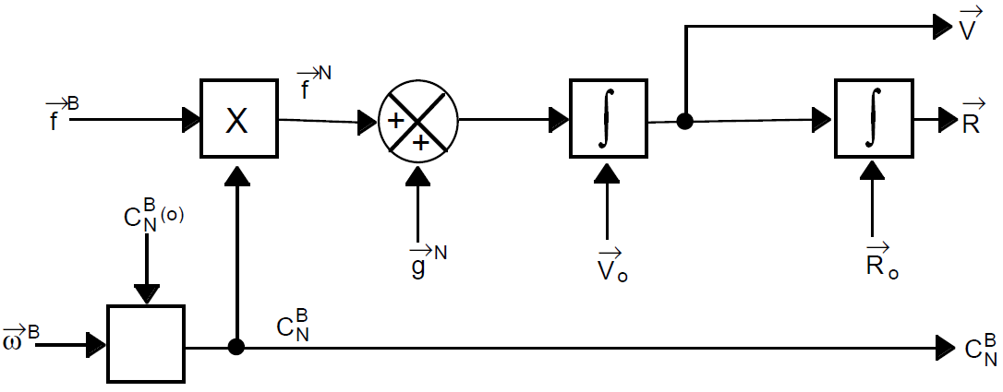
Inertial Navigation System
System View of INS Equations
Diagram from Basic Inertial Navigation by Sherryl Stovall

Slide 24
Navigation Equations
The navigation equations can be represented as (Shin, 2001):

Slide 25
Navigation Equations
Body→NED

Slide 26
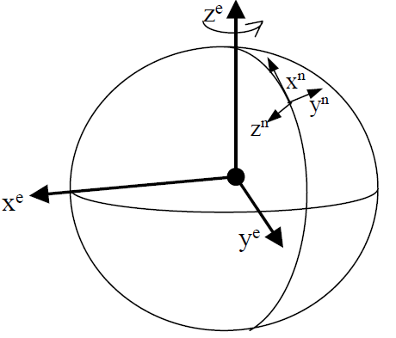
Navigation Equations
GPS and INS need to be in the same reference frame for proper measurements.
GPS data is in Earth Centered Earth Fixed (ECEF)
INS data is in Body frame
and has to be translated
to the North-East-Down
frame
Body→NED, ECEF→NED
Picture from “Accuracy and Improvement of Low Cost INS/GPS for Land Applications” by Shin

Slide 27
Integration of GPS and INS
Different integration levels:
  Loosely Coupled
    Corrects errors in the IMU and INS
    Does not correct GPS
  Tightly Coupled
    Corrects both INS and GPS errors
Kalman filtering integrates both systems to achieve a more accurate overall system

Slide 28
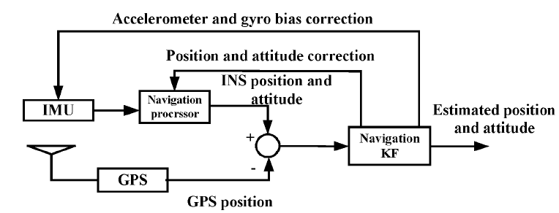
GPS/INS Integration
System View of Integration
Diagram from http://inderscience.metapress.com/media/59dam5dyxldjpg54uc5v/contributions/8/3/w/2/83w217t06m878447.pdf

Slide 29
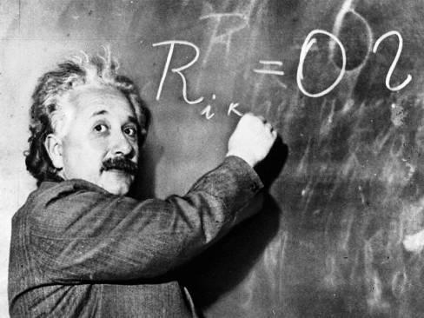
Questions?

